Slide 1


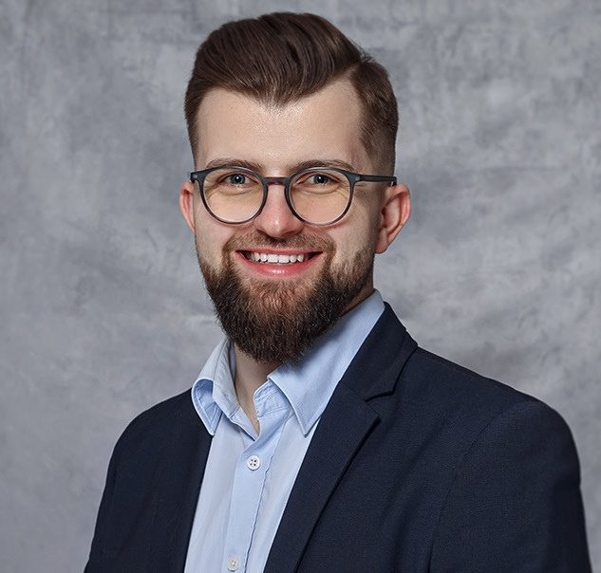
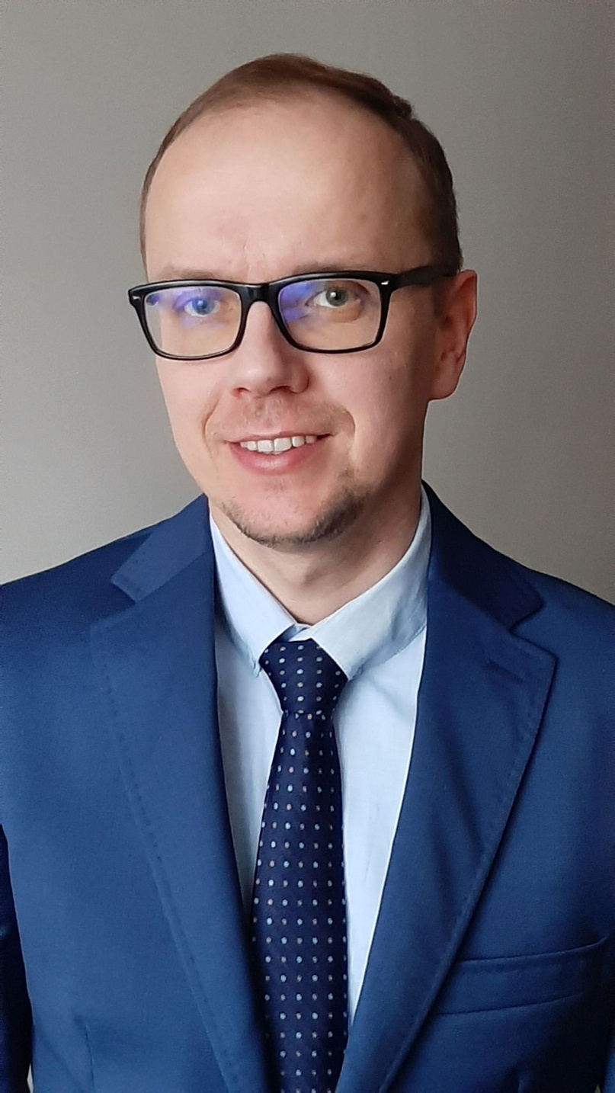


MODEL-DRIVEN APPS:
FROM ZERO TO HERO
IGOR BELCZEWSKI
PIOTR RUSAK
27 JANUARY 2024
PPNT GDYNIA, POLAND

Slide 2

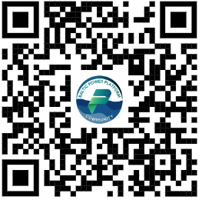
ABOUT PIOTR
Piotr Rusak
Power Platform Lead, Bossard Group
- 17+ years experience with Microsoft technologies
- 16 years experience with SharePoint
(different flavours / SharePoint close to my ❤️)
- With Power Platform since the beginning 2016
- Polish community Speaker and Mentor
#BalticSummit2023
#BalticPPCommunity

Slide 3
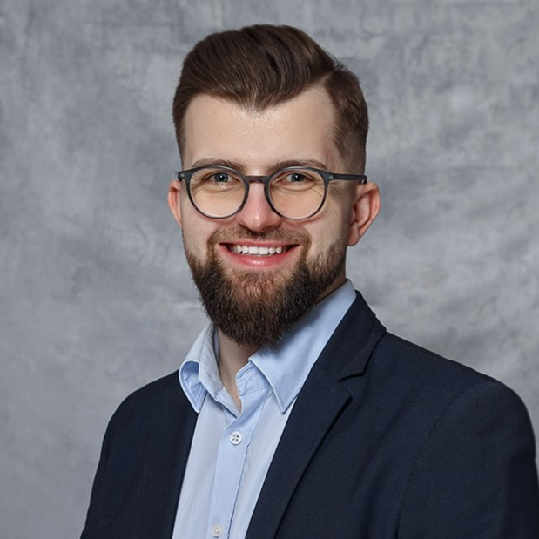
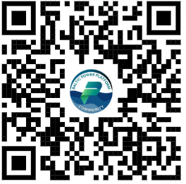
ABOUT IGOR
Igor Belczewski
Power Platform Developer, Sii Polska
- 3+ years experience with Power Platform, mostly with Model-driven Apps
#BalticSummit2023
#BalticPPCommunity

Slide 4
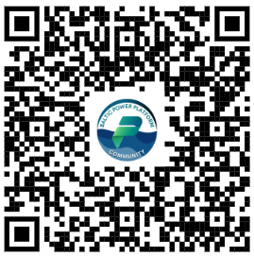
PREREQUISITES
We need to prepare space for our workshop and playground for all our activities today
https://github.com/PRusakPL/Baltic-PP-Community---January-2024-Meetup
#BalticSummit2023
#BalticPPCommunity

